Slide 1
Software Evolution and Quality: Refactoring and Code Smells Explained
Damian A. Tamburri, Ph.D.
Notes:
------------------------------------------------------------------
------------------------------------------------------------------
-------------------------------------------------------------------
--------------------------------------------------------------------
1

Slide 2


Slide 3

HEADS UP!
As of next week, Thu. lecture in the afternoon 2PM, same room!

Slide 4
Who is doing the Code Smells Detection Practicum?

Slide 5
Team ID | Practicum
1
2
3
4
5
6
7
8

Slide 6
Why do good developers write bad software?
Requirements change over time, making it hard to update your code (leading to less optimal designs)
Time and money cause you to take shortcuts
You learn a better way to do something (the second time you paint a room, it’s always better than the first because you learned during the first time!)
Two questions:
How do we fix our software?
How do we know our software is “bad”… when it works fine!

Slide 7
Why do good developers write bad software?
Requirements change over time, making it hard to update your code (leading to less optimal designs)
Time and money cause you to take shortcuts TECH. DEBT
You learn a better way to do something (the second time you paint a room, it’s always better than the first because you learned during the first time!)
Two questions:
How do we fix our software?
How do we know our software is “bad”… when it works fine!

Slide 8
Why do good developers write bad software?
Requirements change over time, making it hard to update your code (leading to less optimal designs)
Time and money cause you to take shortcuts TECH. DEBT
You learn a better way to do something (the second time you paint a room, it’s always better than the first because you learned during the first time!)
Two questions:
How do we fix our software?
How do we know our software is “bad”… when it works fine(ish)!

Slide 9
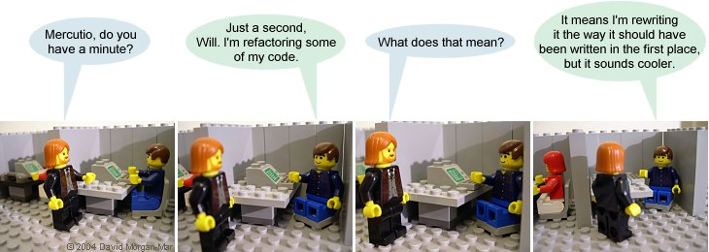
Refactoring: a Refresh
Definition: Refactoring modifies software to improve its readability, maintainability, and extensibility without changing what it actually does.
External behavior does NOT change
Internal structure is improved

Slide 10
General Idea
Developers continuously modify, enhance and adapt software.
As software evolves and strays away from its original design, three things happen.
Decreased understandability
Decreased reliability
Increased maintenance cost
Decreased understandability is due to
Increased complexity of code
Out-of-date documentation
Code not conforming to standards

Slide 11
General Idea
Decrease the complexity of software by improving its internal quality by restructuring the software.
Restructuring applied on object-oriented software is called refactoring.
Restructuring means reorganizing software (source code + documentation) to give it a different look, or structure.

Slide 12
General Idea
Source code is restructured to improve some of its non-functional requirements:
Readability
Extensibility
Maintainability
Modularity
Restructuring does not modify the software’s functionalities.
Restructuring can be performed while adding new features.

Slide 13
General Idea
Software restructuring is informally stated as the modifications of software to make it
easier to understand;
easier to change;
easier to change its documentation;
less susceptible to faults when changes are made to it.

Slide 14
General Idea
A higher level goal of restructuring is to increase the software value
external software value: fewer faults in software is seen to be better by customers
internal software value: a well-structured system is less expensive to maintain
Simple examples of restructuring
Pretty printing
Meaningful names for variables
One statement per line of source code

Slide 15
General Idea
Characteristics of restructuring and refactoring
The objective of restructuring and refactoring is to improve the internal and external values of software.
Restructuring preserves the external behavior of the original program.
Restructuring can be performed without adding new requirements.
Restructuring generally produces a program in the same language.
Example: a C program is restructured into another (more modular) C program.

Slide 16
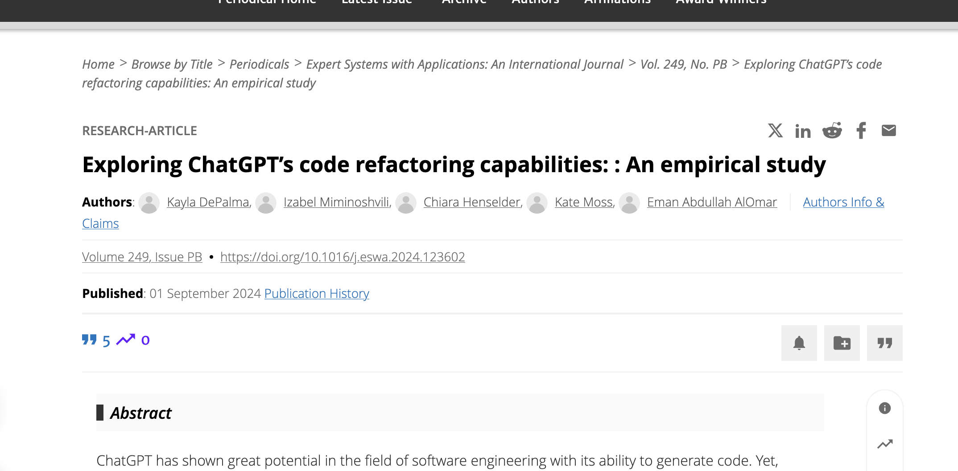
~50 suggestions over 250 LoC
49x valuable refactorings, can auto-apply
“However, human programmers are still needed to oversee these changes and determine their significance. ”

Slide 17
Identify what to refactor
The programmer identifies what to refactor from a set of high-level software artifacts.
source code;
design documents; and
requirements documents.
Next, focus on specific portions of the chosen artifact for refactoring.
Specific modules, functions, classes, methods, and data can be identified for refactoring.

Slide 18
Identify what to refactor
The concept of code smell is applied to source code to detect what should be refactored.
A code smell is any symptom in source code that possibly indicates a deeper problem.
Examples of code smell are:
duplicate code;
long parameter list;
long methods;
large classes;
message chain.

Slide 19
Identify what to refactor
Entities to be refactored at the design level
software architecture;
class diagram;
statechart diagram; and
activity diagrams;
global control flow; and
database schemas.

Slide 20
Determine which refactorings to apply
Common refactorings are
R1: Rename method print to process in class PrintServer.
R2: Rename method print to process in class FileServer. (R1 and R2 are to be done together.)
R3: Create a superclass Server from PrintServer and FileServer.
R4: Pull up method accept from PrintServer and FileServer to the superclass Server.
R5: Move method accept from PrintServer to class Packet, so that data packets themselves will decide what actions to take.
R6: Move method accept from FileServer to Packet.
R7: Encapsulate field receiver in Packet so that another class cannot directly access this field.
R8: Add parameter p of type Packet to method print in PrintServer to print the contents of a packet.
R9: Add parameter p of type Packet to method save in class FileServer so that the contents of a packet can be printed.

Slide 21
Determine which refactorings to apply.
Class diagram of a Local Area Network (LAN) simulator [6]
(©[2007] Springer).

Slide 22
Determine which refactorings to apply
R1—R9 indicate that a large number of refactorings can be identified even for a small system.
A subset of the entire set of refactorings need to be carefully chosen because of the following reasons.
Some refactorings must be applied together.
Example: R1 and R2 are to be applied together.
Some refactorings must be applied in certain orders.
Example: R1 and R2 must precede R3.
Some refactorings can be individually applied, but they must follow an order if applied together.
Example: R1 and R8 can be applied in isolation. However, if both of them are to be applied, then R1 must occur before R8.
Some refactorings are mutually exclusive.
Example: R4 and R6 are mutually exclusive.

Slide 23
Determine which refactorings to apply
Tool support is needed to identify a feasible subset of refactorings.
The following two techniques can be used to analyze a set of refactorings to select a feasible subset.
Critical pair analysis
Given a set of refactorings, analyze each pair for conflicts. A pair is said to be conflicting if both elements cannot be applied together.
Example: R4 and R6 constitute a conflicting pair.
Sequential dependency analysis
In order to apply a refactoring, one or more refactorings must be applied before.
If one refactoring has already been applied, a mutually exclusive refactoring cannot be applied anymore.
Example: after applying R1, R2, and R3, R4 becomes applicable. Now, if R4 is applied, then R6 is not applicable anymore.

Slide 24
Can an LLM help with this?
Nope.
It can propose options of consequence for you to evaluate;
It can guess consequences by figuring out code (re-)structure;
It cannot ideally execute the code to evaluate the impacts (e.g., the refactoring preserves sw. behavior);

Slide 25
Ensure that refactoring preserves the software’s behavior.
Ideally, the input/output behavior of a program after refactoring is the same as the behavior before refactoring.
In many applications, preservation of non-functional requirements is necessary.
A non-exclusive list of such non-functional requirements is as follows:
Temporal constraints: A temporal constraint over a sequence of operations is that the operations occur in a certain order.
For real-time systems, refactorings should preserve temporal constraints.
Resource constraints: The software after refactoring does not demand more resources: memory, energy, communication bandwidth, and so on.
Safety constraints: It is important that the software does not lose its safety properties after refactoring.

Slide 26
Ensure that refactoring preserves the software’s behavior.
Two pragmatic ways of showing that refactoring preserves the software’s behavior.
Testing
Exhaustively test the software before and after applying refactorings, and compare the observed behavior on a test-by-test basis.
Verification of preservation of call sequence
Ensure that the sequence(s) of method calls are preserved in the refactored program.

Slide 27
Apply the refactorings to chosen entities

Slide 28
Evaluate the impacts of the Refactorings on Quality
Refactorings impact both internal and external qualities of software.
Some examples of internal qualities of software are
size, complexity, coupling, cohesion, and testability
Some examples of external qualities of software are
performance, reusability, maintainability, extensibility, robustness, and scalability

Slide 29
Evaluate the impacts of the Refactorings on Quality
In general, refactoring techniques are highly specialized, with one technique improving a small number of quality attributes.
For example,
some refactorings eliminate code duplication;
some raise reusability;
some improve performance; and
some improve maintainability.

Slide 30
Evaluate the impacts of the Refactorings on Quality
By measuring the impacts of refactorings on internal qualities, their impacts on external qualities can be measured.
Example of measuring external qualities
Some examples of software metrics are coupling, cohesion, and size.
Decreased coupling, increased cohesion, and decreased size are likely to make a software system more maintainable.
To assess the impact of a refactoring technique for better maintainability, one can evaluate the metrics before refactoring and after refactoring, and compare them.

Slide 31
Maintain consistency
Rather than evaluate the impacts after applying refactorings, one selects refactorings such that the program after refactoring possesses better quality attributes.
The concept of soft-goal graph helps selecting refactorings.
Example: A soft-goal graph for quality attribute “maintainability” is a hierarchical graph rooted at the desired change in the attribute, for example, high maintainability.
The internal nodes represent successive refinements of the attribute and are basically the soft goals.
The leaf nodes represent refactoring transformations which contribute positively/negatively to soft-goals which appear above them in the hierarchy.

Slide 32
Maintain consistency
An example of a soft goal graph for maintainability,
with one leaf node [11] (© [2002] IEEE).

Slide 33
Formalisms for Refactoring
Three key formalisms for refactoring are:
assertions:
Assertions are useful in verifying the assumptions made by programmers.
graph transformation:
Graph transformation is useful in viewing refactorings as applications of transformation rules.
metrics:
Metrics are useful in quantifying to what extent the internal and external properties of software entities have changed.

Slide 34
Assertions
Programmers make assumptions about the behavior of programs at specific points, and those assumptions can be tested by means of assertions.
An assertion is specified as a Boolean expression which evaluates to true or false.
Three kinds of assertions:
invariants;
preconditions; and
postconditions.

Slide 35
Assertions
Invariant
An invariant is an assertion that evaluates to true wherever it is invoked in the program.
A class invariant is an invariant that all instances of that class must satisfy.
Precondition
A precondition is a condition that must be satisfied before a computation is performed.
Postcondition
A postcondition is a condition that must be satisfied after a computation is performed.

Slide 36
Assertions
Invariants, preconditions, and postconditions can be applied to test the behavior preserving property of refactorings.
Examples of invariant in the context of transformation of database schema is:
All instance variables of a class, whether defined or inherited, have distinct names.
All methods of a class, whether defined or inherited, have distinct names.
Note: Static checking of preconditions, postconditions, and invariants is computationally expensive.

Slide 37
Graph Transformation
Programs, class diagrams, and statecharts can be viewed as graphs, and refactorings can be viewed as graph production rules.
Classes (C), method signatures (M), block structures (B), variables (V), parameters (P), and expressions (E) are represented by typed nodes in a graph.
The possible relationships among the nodes are:
method lookup (l); -- inheritance (i);
membership (m); -- (sub)type (t);
expression (e); -- actual parameter (ap);
formal parameter (fp); -- cascaded expression (•);
call (c); -- variable access (a); and
update (u).

Slide 38
Graph Transformation
An example of a program graph [13] (© [2006] Elsevier).

Slide 39
Formalisms for Refactoring
Program graph obtained after applying push-down-method refactoring to the program graph of the prev. figure (© [2006] Elsevier).

Slide 40
A better way…
Ok forget formalisms… is there a more “operational” way?
40

Slide 41
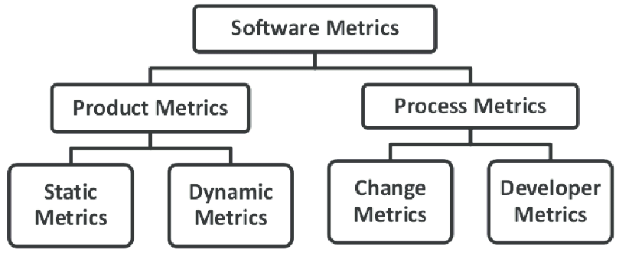

Slide 42
Software Metrics
Software metrics can be used to quantify the internal and external qualities of software.
A module consists of many components; each component provides a defined functionality used by other components.
Measure the strength of togetherness of components within a module to decide whether or not some components should stay in the same module.

Slide 43
Software Metrics*
Two key metrics considered are:
cohesion; and
coupling.
Cohesion: This metric is used to represent the strength of togetherness in the same module.
Coupling: This metric is used to represent the strength of dependency between separate modules.
* More on metrics to follow on next lectures!

Slide 44
More Examples of Refactoring
More examples are intuitively explained here.
Substitute algorithm;
Replace parameter with methods;
Push Down Method;
Parameterize Methods;
Substitute algorithm
Replace algorithm X with algorithm Y: (i) because implementation of Y is clearer than X; (ii) Y performs better than X; and (iii) standardization bodies want X to be replaced with Y.
Algorithm substitution is easier if both X and Y have the same input-output behaviors.

Slide 45
More Examples of Refactoring
Replace parameters with methods
Consider the following code segment, where the method bodyMassIndex has two formal parameters.
int person;
:
// person is initialized here;
:
int bodyMass = getMass(person);
int height = getHeight(person);
int BMI = bodyMassIndex(bodyMass, height);
:
The above code segment can be rewritten such that the new bodyMassIndex method accepts one formal parameter, namely, person, and internally computes the values of bodyMass and height.

Slide 46
More Examples of Refactoring
Push Down Method
Assume that Executive and Clerk are two subclasses of the superclass Employee, as shown in Fig. 7.7(a).
Method overTimePay has been defined in Employee class.
If overTimePay is used in the Clerk class, but not in the Executive class, then the programmer can push down overTimePay to the Clerk class, is shown in Fig. 7.7(b).
Illustration of the Push Down Method refactoring:
(a) the class diagram before refactoring;
(b) the class diagram after refactoring.

Slide 47
More Examples of Refactoring
Parameterize Methods
Sometimes programmers may find multiple methods performing the same computations on different input data sets.
Those methods can be replaced with a new method with additional formal parameters, as illustrated in Fig. 7.8.
In Fig. 7.8(a), we have the Communication class with four methods: bluetoothInterface, wifiInterface, threeGInterface, and fourGInterface.
In Fig. 7.8(b), we have the Communication class with just one method, namely, wirelessInterface with one parameter, namely, radio.
The method wirelessInterface can be invoked with different values of radio so that the wirelessInterface method can in turn invoke different radio interfaces.

Slide 48
Factors Influencing Software Structure
Code
Code quality at all levels of details (e.g. variables, constants, statements, function, and module) impact code understanding.
Adherence to coding standards improves code quality.
Adoption of common architectural styles enhances code understanding.
Documentation
Internal documentation (also known as in-line codumentation)
External documentation
Requirements documents
Design documents
User manuals
Test cases

Slide 49
Factors Influencing Software Structure
Tools – Programming environment
Development tools help programmers better understand the code.
Tracing of source code help in understanding the dynamic behavior of the code.
Animation of algorithms help in understanding the dynamic strategy adopted in algorithms.
Cross referencing of global variables reveal interactions among modules.
Tools can reformat code for better readability via pretty printing, highlighting of key words, and color coding of source code.
Programmers
Qualities of programmers influence their perception of structure.
Examples of programmer qualities
Individual capabilities
Education
Experience and training
Aptitude

Slide 50
Factors Influencing Software Structure
Managers and policies
Management can play an influencing role in having a good initial structure and sustain it by designing policies and allocating resources.
Examples
Management can design general policies to adhere to standards.
Management can tie the annual performance review with the programmer’s adherence to standards.
Environment
This refers to the general working environment of programmers.
Example: Physical facilities and availability of resources when needed

Slide 51
Classification of Restructuring Approaches
Approaches not involving code changes
Upgrade documentation
Make in-line comments more accurate and readable.
Update comments to reflect code changes.
Update external documentations to make them consistent with code, accurate, and complete.

Slide 52
Classification of Restructuring Approaches
Approaches involving code changes
Practices: Some examples of restructuring practices are:
Restructuring code with preprocessors.
Making code understandable by means of inspection.
Formatting code by adhering to standards and style guidelines.
Restructuring code for reusability.
Techniques: Some approaches are based on defined techniques.
Incremental restructuring
Goto-less approach
Case-statement approach
Boolean flag approach
Clustering approach
Tools
Eclipse IDE, IntelliJ IDEA, jFactor, Refactorit, and Clone Doctor

Slide 53
Restructuring Techniques
Localization and Information-Hiding Approach
Localization
It is a process of collecting the logically related computational resources in one physical module.
Functions, procedures, operations, and data types are computational resources.
By localizing computational resources into separate modules, programmers can restructure a program into a loosely coupled system of sufficiently independent modules.
Sometimes, localization is difficult to achieve.
A variable may be imported into a module by means of the include statement.
Data sharing among functions is not explicitly represented in source code.

Slide 54
Restructuring Techniques
Localization and Information Hiding Approach
Information Hiding
The details of implementations of computational resources can be hidden to make it easier to understand the program.
For example, a queue is a high level concept which can be implemented by means of a variety of low level data structures.
Singly linked list
Doubly linked list
Arrays
A programmer can design a function by using enqueue and dequeue calls without any concern for their actual implementations.

Slide 55
Restructuring Techniques
Localization and Information Hiding Approach
A restructuring process based on localization of variables and functions
Localization of variables
Organize global variables and functions which refer to those global variables into package-like groups.
This organization can be achieved by applying the concept of closure of functions to a set of global variables.
This leads to groups of functions and global variables referred to by those functions.
Localization of functions
Put locally called functions and the calling function in the same group.
Information hiding and hierarchical structuring
Organize groups of functions into hierarchical package structures based on the visibility of functions within groups.
Those functions and variables which are only externally referable and visible to other packages constitute the package specification.

Slide 56
Restructuring Techniques
System Sandwich Approach
This approach is applied to those software which cannot be restructured with any hope, but need to be retained for their outputs.
As illustrated in the figure below, write a new front-end interface and a new back-end data base so that:
it is easy to interface with the program; and
the program’s outputs are recorded in a more structured way.
System sandwich approach to software restructuring. The arrows represent the flow of data and/or commands.

Slide 57
Restructuring Techniques
Clustering Approach
Software modularization is an important design step.
A program can be remodularized in two ways.
System level remodularization
This is a top-down approach.
Partition the program into smaller modules, as illustrated in Fig. 7.12.
Entity level remodularization
This is a bottom-up approach.
Group a program’s entities to form larger modules.

Slide 58
Restructuring Techniques
Illustration of system level remodularization.
Bullets represent low level entities.
Dotted shapes represent modules.
Arrows represent progression from one level to the next.

Slide 59
Restructuring Techniques
Clustering Approach (Contd.)
The concept of clustering is key to modularization.
Clusters are defined as continuous regions of space containing a relatively high density of points, separated from other such regions by regions containing a relatively low density of points.
Modularization is defined as the clustering of large amount of entities in groups in such a way that the entities in one group are more closely related, based on some similarity metrics.
While applying the idea of clustering, two factors are taken into account:
What similarity metrics to consider?
What clustering algorithm to use?

Slide 60
Restructuring Techniques
Clustering Approach (Contd.)
Similarity metrics
Distance measures
Euclidean distance
Manhattan distance
Association coefficients
Simple matching coefficient
Jaccard coefficient
Examples of association coefficients
Let x and y be two entities. Let:
a = # of features present for both x and y.
b = # of features present for x but not y.
c = # of features present for y but not x.
d = # of features not present for both x and y.
Simple matching coefficient: simple(x, y) = (a + d)/(a + b + c + d).
Jaccard coefficient: Jaccard(x, y) = a/(a + b + c).

Slide 61
Restructuring Techniques
Clustering Approach (Contd.)
Clustering algorithms: three broad techniques applied.
Graph theoretical algorithms
Construction algorithms
Optimization algorithms (aka iterative and improvement algorithms)
Hierarchical algorithms
Divisive algorithms (See Figure 7.12)
Agglomerative algorithms (See Figure 7.13)
The clustering produced by a hierarchical algorithm can be visualized in a dendogram.
The dendogram representation of the hierarchy in Fig. 12 has been shown in Fig. 7.14.

Slide 62
Restructuring Techniques
Clustering Approach (Contd.)
The general structure of an agglomerative algorithm
IF there are N entities, begin with N clusters such that each
cluster contains a unique entity.
Compute the similarities between the clusters.
2. WHILE there is more than a cluster
DO
Find the most similar pair of clusters and merge them into a single cluster.
Recompute the similarities between the clusters.
END

Slide 63
Restructuring Techniques
Dendogram representation of the remodularisation
Illustration of system level remodularization.
Bullets represent low level entities.
Dotted shapes represent modules.
Arrows represent progression from one level
to the next.

Slide 64
Restructuring Techniques
Illustration of entity level remodularization.
Bullets represent low level entities.
Dotted shapes represent modules.

Slide 65
Restructuring Techniques
Program Slicing Approach
Two kinds of program slicing
Backward slicing: The set of statements that can affect the value of a variable at some point of interest in a program is called a backward slice.
Forward slicing: The set of statements that are likely to be affected by the value of a variable at some point of interest in a program is called a forward slide.
A key idea in program slicing
Identify and extract a cohesive subset of statements from a program.
Therefore, if a module supports multiple functionalities, a portion of the code can be extracted to form a new module.
Large functions can be decomposed into smaller functions by means of program slicing to restructure programs.

Slide 66
Danger!
Refactoring LIKELY introduces problems, because anytime you modify software you may well introduce bugs!
Refactoring adds risk!
It’s expensive – we’re spending time in development, but not “seeing” any external differences?
And we still must retest?
Why are we doing this?

Slide 67
How do I identify code to refactor?
Martin Fowler uses “code smells” to identify when to refactor.
Code smells are bad things done in code, somewhat like bad patterns in code
Many people have tied code smells to the specific refactorings to fix the smell

Slide 68
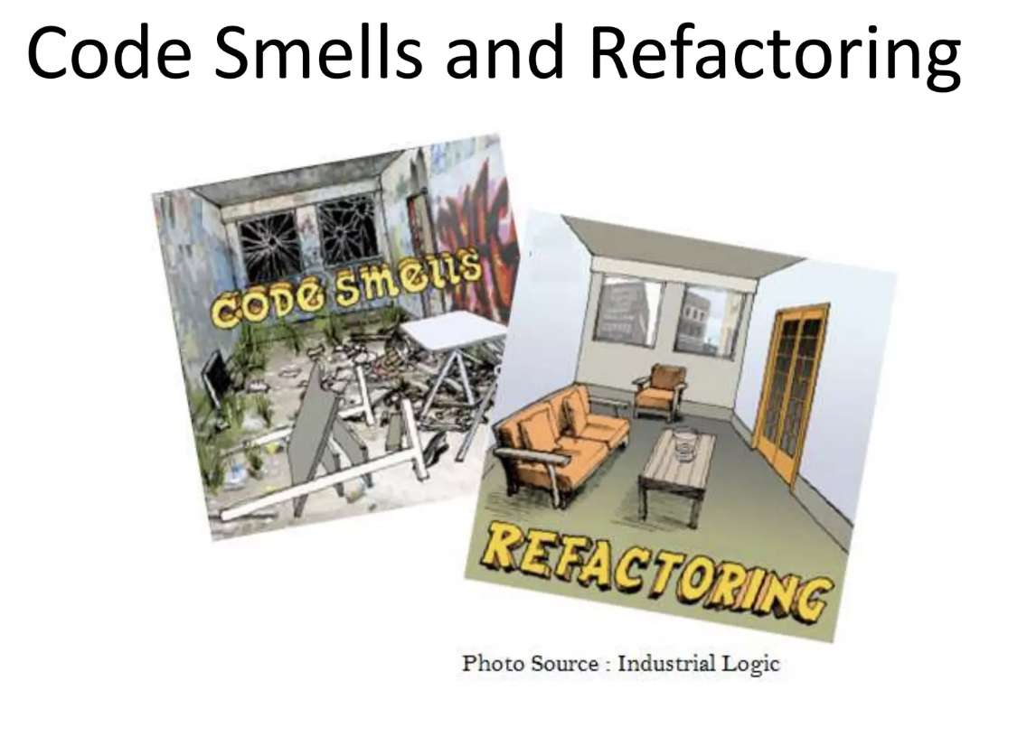

Slide 69
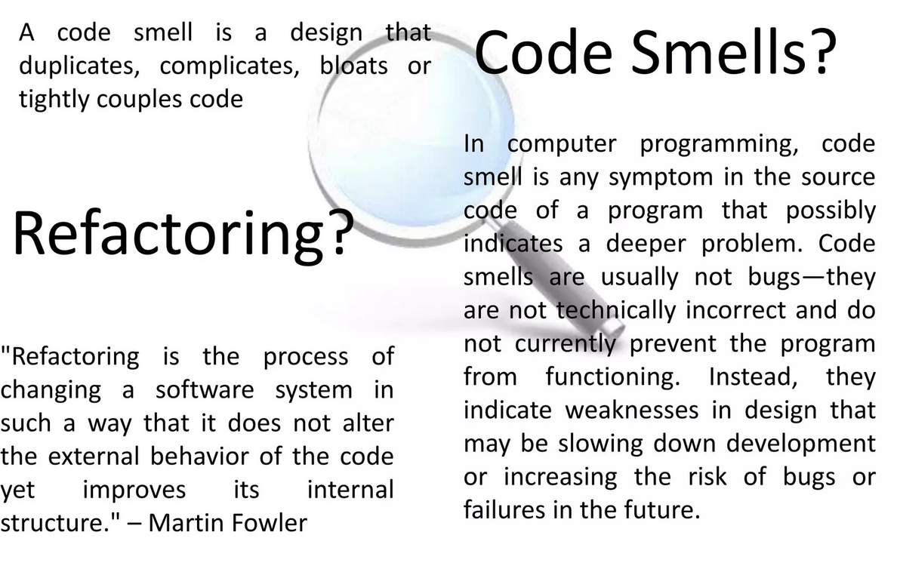

Slide 70
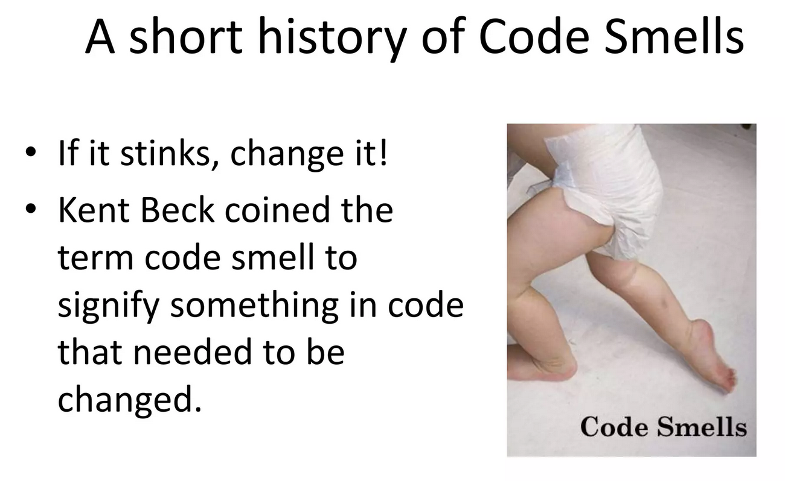

Slide 71
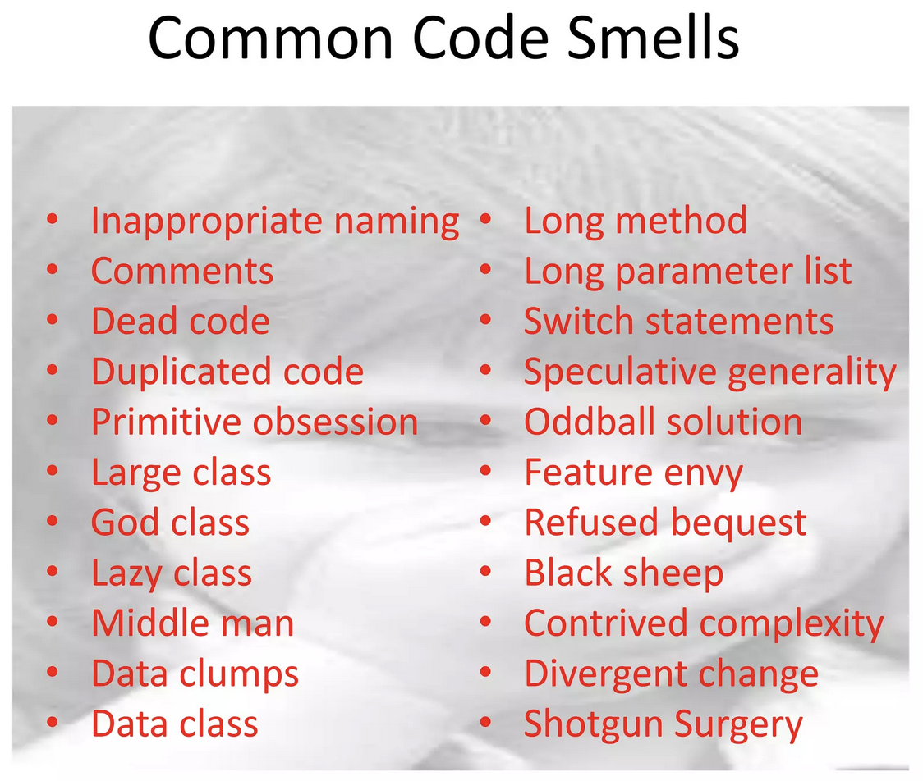

Slide 72
Code Smells
Duplicated Code
bad because if you modify one instance of duplicated code but not the others, you (may) have introduced a bug!
Long Method
long methods are more difﬁcult to understand
performance concerns with respect to lots of short methods are largely obsolete

Slide 73
Code Smells
Large Class
classes try to do too much, which reduces cohesion
Long Parameter List
hard to understand, can become inconsistent
Divergent Change
Related to cohesion: symptom: one type of change requires changing one subset of methods; another type of change requires changing another subset

Slide 74
Code Smells
Lazy Class
A class that no longer “pays its way”
e.g. may be a class that was downsized by a previous refactoring, or represented planned functionality that did not pan out
Speculative Generality
“Oh I think we need the ability to do this kind of thing someday”
Temporary Field
An attribute of an object is only set in certain circumstances; but an object should need all of its attributes

Slide 75
Code Smells
Data Class
These are classes that have ﬁelds, getting and setting methods for the ﬁelds, and nothing else; they are data holders, but objects should be about data AND behavior
Refused Bequest
A subclass ignores most of the functionality provided by its superclass
Subclass may not pass the “IS-A” test
Comments (!)
Comments are sometimes used to hide bad code
“…comments often are used as a deodorant” (!)

Slide 76
Many more code smells
Many more smells at:
http://c2.com/cgi/wiki?CodeSmell
Given a smell, what refactorings are likely applicable?
http://wiki.java.net/bin/view/People/SmellsToRefactorings

Slide 77
Why use them?
Code smells and refactoring are techniques to help you discover problems in design and implementation and apply known solutions to these problems
Should they be used all the time? You should always think about them, but only apply them when they make sense… sometimes you need a long method… but think about it to make sure!

Slide 78
Adding safety
Remember that making these changes incurs some risk of introducing bugs!
To reduce that risk
You must test constantly – using automated tests wherever possible
Use refactoring patterns – I’ve shown you two… there are more.. many more!
http://www.refactoring.com/catalog/index.html
Use tools! Netbeans and Eclipse both support basic refactoring (http://wiki.netbeans.org/Refactoring)

Slide 79
Question for your boss
"Refactoring is an overhead activity - I'm paid to write new, revenue generating features."
Tools/technologies are now available to allow refactoring to be done quickly and relatively painlessly.
Experiences reported by some object-oriented programmers suggest that the overhead of refactoring is more than compensated by reduced efforts and intervals in other phases of program development.
While refactoring may seem a bit awkward and an overhead at first, as it becomes part of a software development regimen, it stops feeling like overhead and starts feeling like an essential.
Quoted from: http://st-www.cs.illinois.edu/users/opdyke/wfo.990201.refac.html

Slide 80
Question for your boss
"Refactoring is an overhead activity - I'm paid to write new, revenue generating features."
Tools/technologies are now available to allow refactoring to be done quickly and relatively painlessly.
Experiences reported by some object-oriented programmers suggest that the overhead of refactoring is more than compensated by reduced efforts and intervals in other phases of program development.
While refactoring may seem a bit awkward and an overhead at first, as it becomes part of a software development regimen, it stops feeling like overhead and starts feeling like an essential.
➔AI!
Quoted from: http://st-www.cs.illinois.edu/users/opdyke/wfo.990201.refac.html

Slide 81
Summary
Refactoring improves the design of software
without refactoring, a design will “decay” as people make changes to a software system
Refactoring makes software easier to understand
because structure is improved, duplicated code is eliminated, etc.
Refactoring helps you find bugs
Refactoring promotes a deep understanding of the code at hand, and this understanding aids the programmer in finding bugs and anticipating potential bugs
Refactoring helps you program faster
because a good design enables progress

Slide 82
References
Comic from: http://www.irregularwebcomic.net/cgi-bin/comic.pl?comic=687
http://www.refactoring.com/catalog/index.html
http://www.cs.colorado.edu/~kena/classes/6448/s05/lectures/lecture18.pdf
http://www.codeproject.com/KB/architecture/practicalexp.aspx

